Slide 1
CycleGAN

Slide 2
Image to image translation
Image-to-image translation is a class of vision and graphics problems where the goal is to learn the mapping between an input image and an output image using a training set of aligned image pairs. However, for many tasks, paired training data is not available. The paper presents an approach for learning to translate an image from a source domain X to a target domain Y in the absence of paired examples.

Slide 3
The paper presents a method that can learn to capture special characteristics of one image collection and figure out how these characteristics could be translated into the other image collection, all in the absence of any paired training examples.
It assumes there is some underlying relationship between the domains and although it lacks supervision in the form of paired examples, the model can exploit supervision at the level of sets: It is given one set of images in domain X and a different set in domain Y.

Slide 4
Cycle
The introduction of a cyclic loss prevents mode collapse, where all input images map to the same output image and the optimization fails to make progress. The generator collapses which produces limited varieties of samples.
It should be “cycle consistent”, in the sense that if it translates, e.g., a sentence from English to French, and then translate it back from French to English, it should arrive back at the original sentence

Slide 5
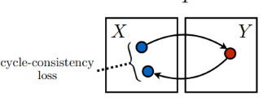
Loss
The key to GANs’ success is the idea of an adversarial loss that forces the generated images to be indistinguishable from real photos. This loss is particularly powerful for image generation tasks, as this is the objective that much of computer graphics aims to optimise.
To further regularise the mappings, the paper introduces two cycle consistency losses that capture the idea that if you translate from one domain to the other and back again you should arrive at where we started

Slide 6
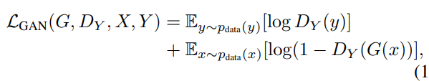

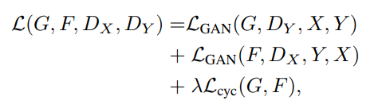
Adversarial loss
Cycle consistency loss

Slide 7
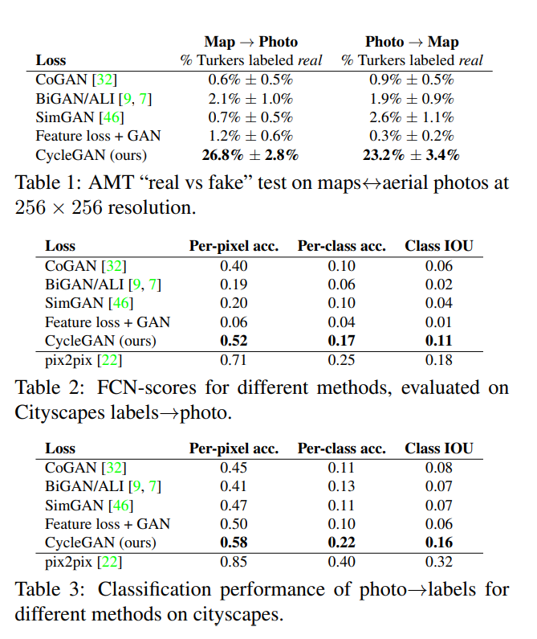
Model comparison
CycleGAN was tested against CoGAN, BiGAN, SimGAN and Feature loss + GAN.
Results show the success of the CycleGAN for unpaired image to image translation
Was also compared against pix2pix to see how close it was to a model that used paired data.

Slide 8
Unlike recent work on “neural style transfer”, their method learns to mimic the style of an entire collection of artworks, rather than just transferring the style of a single selected piece of art. Therefore, you can learn to generate photos in the style of, e.g., Van Gogh, rather than just in the style of Starry Night.

Slide 9
They also explored tasks that require geometric changes, with little success. For example, on the task of dog to cat transfiguration, the learned translation ended up making minimal changes to the input. This failure might have been caused by the generator architectures which are tailored for good performance on the appearance changes. Handling more varied and extreme transformations, especially geometric changes, is an important problem for future work.

Slide 10
VIGAN

Slide 11
What is VIGAN?
VIGAN tackles the problem of ensuring the quality or completeness of data – the missing data problem.
The method proposed in the paper can handle both the multi-view (where different views describe distinct perspectives) and multi-modal (data for more than one model) missing data problem.
Most existing statistical or machine learning methods do not handle it and thus require the missing data to be imputed before the statistical methods can be applied

Slide 12
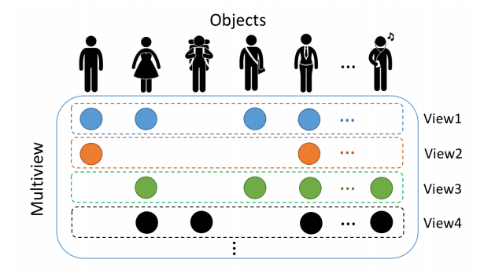
Prior works assume that all views are available, and only some variables in each view are missing.
As a result of research on imputation in multi-view settings, missing values in a view can now be imputed based on information from another complete view

Slide 13
Model Stages
a multi-modal autoencoder is trained on paired data to embed and reconstruct the input views
train a cycle consistent GAN with unpaired data allowing a cross domain relationship to be inferred.
re-optimise both the pre-trained multi-modal autoencoder and the pretrained cycle-consistent GAN so that we integrate the cross-domain relationship learned from unpaired data and the view correspondences learned from paired data
use the autoencoder to refine the estimate by denoising the GAN outputs

Slide 14
Both paired and unpaired data are employed to learn mappings or correspondences between domains X and Y .
The denoising autoencoder is used to learn a shared representation from pairs (x, y) and is pretrained.
The cycle-consistent GAN is used to learn from unpaired examples {x}, {y} randomly drawn from the data to obtain maps between the domains

Slide 15
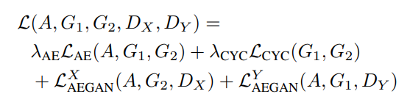
To jointly optimise both the DAE and CycleGAN, in the last stage, they minimise an overall loss function
That loss function is composed of:
The loss of multi-modal denoising autoencoder
The adversarial loss
The cycle consistency loss

Slide 16
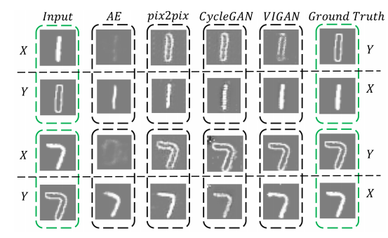
Testing
Using the MNIST dataset
54000 training
10000 test
6000 validation
Original digit was the first view and the edge images were the second view.
The network was trained assuming either view could be completely missing

Slide 17
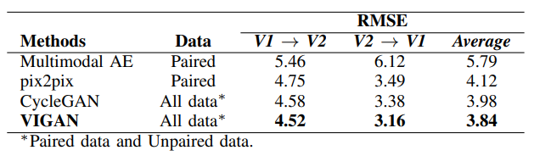
Comparison of the root mean square errors between VIGAN and other effective imputation methods.
Pix2Pix and CycleGAN performed better than the multimodal DAE because they can be trained on both unpaired and paired data, allowing for more training samples.

